Slide 1





[B;T]
Competitive
Programming
Training
Session #2

Slide 2

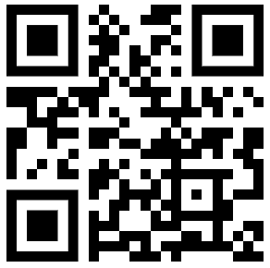
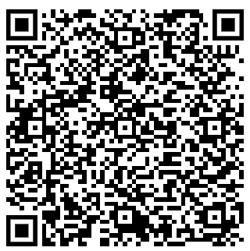

linktr.ee
Teams
Follow our Instagram
msubearsintech
@

Slide 3

Agenda
Basics C++
Control Structures (Conditionals)
Nested if statements
Prob. String Task
Nested loops
Prob. Printing Staircase
Prob. A Way Too Long Words
Prob. Translation

Slide 4

Homework Problems
Contest on Virtual Judge: https://vjudge.net/contest/594338#overview
Review hw questions on Nov. 29th.
Learn from math
Watermelon
Staircase
Drinks
Problem 1 link
problem 2 link
problem 3 link
problem 4 link

Slide 5
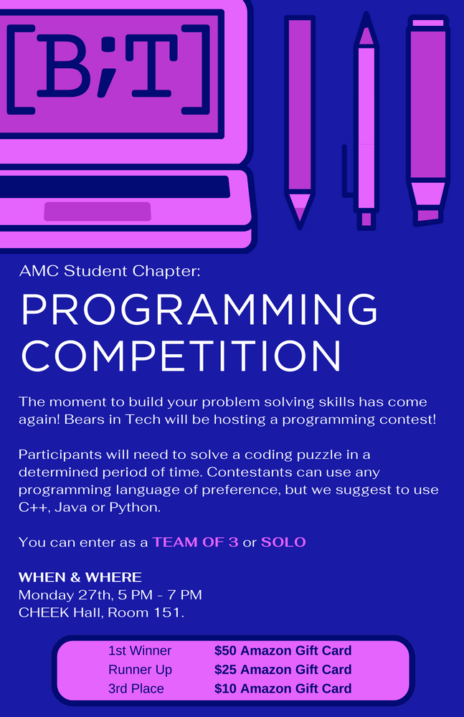
Happy Thanksgiving
Enjoy Your Break
linktr.ee
Teams
Follow our Instagram
msubearsintech
@

